Slide 1

WHAT DID WE LEARN THIS TIME?
About and why we choose Ionic
How to get started with Ionic
The Ionic navigation stack
How to use various Ionic components
How to structure and theme an app

Slide 2
THIS SECTION’S BIG CHALLENGE!
If you haven’t already, start a new Ionic app and add the required components
For bonus points, get feed back from at least one person on your app – ways you can do this are:
Share it with the rest of the group on our Discord channel and swap ideas and critique each others plans
Or ask a family member or a friend
Post it on Twitter, Reddit, Facebook etc.

Slide 3
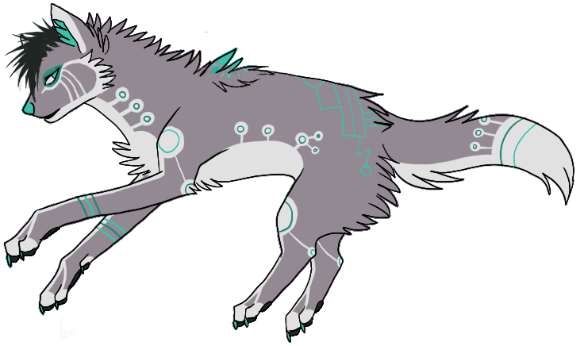
Need help?
Github:
http://www.github.com/webdevelopwolf/training
Twitter:
http://www.twitter.com/webdevelopwolf
Facebook:
http://www.facebook.com/webdevwolf
Discord:
https://discord.gg/jWGvtnZ

Slide 4

Next Section…
We’re going to be learning all about Dynamic Data Storage and the role it’s going to play in our project…

